Slide 1
Vector Databases
Padmavathi Madisetty

Slide 2
List of Traditional Databases
Oracle Database
Microsoft SQL Server
MySQL
PostgreSQL
IBM Db2
SQLite
Microsoft Access
IBM Informix
Sybase ASE (Adaptive Server Enterprise)
Teradata

Slide 3
List of Vector Databases
Chroma
Faiss
Pinecone
Milvus
Weaviate
Deep Lake
Qdrant
Elasticsearch
Vespa
Vald
ScaNN
Pgvector
ClickHouse
OpenSearch

Slide 4
Real-time Analytics
Lock-in
Schema Flexibility
Cost
Data Variety – supports structured data only
High Availability and Fault Tolerance
Performance
Security and Compliance
Challenges of traditional databases
Scalability
Complexity of Operations

Slide 5
What is a Vector Database?
A vector database is a database that stores information as vectors, which are numerical representations of data objects, also known as vector embeddings.
Vector databases are built to manage vector embeddings, and therefore offer a complete solution for the management of unstructured and semi-structured data.
Notes:
A vector database organizes data through high-dimensional vectors. High-dimensional vectors contain hundreds of dimensions, and each dimension corresponds to a specific feature or property of the data object it represents, generated by large language models and other AI models.

Slide 6
Vector databases VS Traditional Databases

Slide 7
Traditional Databases | Vector Databases
Data Structure: Store data in structured tables with rows and columns, often following a relational model. They are suitable for structured data types and transactions. | Data Structure: designed for handling high-dimensional, often unstructured or semi-structured data, such as embeddings, vectors, and time-series data. They typically store data in vectorized formats optimized for similarity search and analytics.
Querying: SQL (Structured Query Language) for querying. SQL provides powerful capabilities for filtering, joining, and aggregating structured data. | Querying: often use specialized query languages or APIs tailored for similarity search and analytics tasks, which include operations like nearest neighbor search, similarity search, clustering, and classification
Use Cases: used in transactional systems, such as banking, e-commerce, and inventory management, where ACID (Atomicity, Consistency, Isolation, Durability) properties are crucial. | Use Cases: Well-suited for use cases involving high-dimensional data, such as recommendation systems, image and video analysis, natural language processing, anomaly detection, and time-series analysis.
Performance: Optimized for OLTP (Online Transaction Processing) workloads, focusing on efficient transaction processing and data integrity | Performance: Optimized for OLAP (Online Analytical Processing) workloads, with a focus on fast analytics and similarity search operations over large datasets
Scalability: These are often supporting horizontal scalability through techniques like sharding and replication. However, scaling can be complex and may have limitations. | Scalability: Vector databases are designed with scalability in mind, often leveraging distributed architectures to handle large volumes of high-dimensional data efficiently
Indexing: Typically use B-tree or hash indexes to speed up data retrieval for queries. | Indexing: employ specialized indexing techniques such as tree-based structures (e.g., KD-trees, VP-trees) or hashing methods optimized for similarity search in high-dimensional spaces.
Notes:
A traditional database stores information in tabular form, and indexes data by assigning values to data points. When queried, a traditional database will return results that exactly match the query.
A vector database stores vectors in the form of embeddings and enables vector search, which returns query results based on similarity metrics (rather than exact matches). A vector database "steps up" where a traditional database cannot: It is intentionally designed to operate with vector embeddings.
A vector database is also better suited than a traditional database in certain applications, such as similarity search, artificial intelligence, and machine learning applications, because it enables high-dimensional search and customized indexing, and because it is scalable, flexible, and efficient.
A traditional database stores information in tabular form, and indexes data by assigning values to data points. When queried, a traditional database will return results that exactly match the query.
A vector database stores vectors in the form of embeddings and enables vector search, which returns query results based on similarity metrics (rather than exact matches). A vector database "steps up" where a traditional database cannot: It is intentionally designed to operate with vector embeddings.
A vector database is also better suited than a traditional database in certain applications, such as similarity search, artificial intelligence, and machine learning applications, because it enables high-dimensional search and customized indexing, and because it is scalable, flexible, and efficient.

Slide 8
Aspect | Traditional Databases | Vector Databases
Data Type | Simple data (words, numbers) in a table format. | Complex data (vectors) with specialized searching.
Search Method | Exact data matches. | Closest match using Approximate Nearest Neighbor (ANN) search.
Search Techniques | Standard querying methods. | Specialized methods like hashing and graph-based searches for ANN.
Handling Unstructured Data | Challenging due to lack of predefined format. | Transforms unstructured data into numerical representations (embeddings).
Representation | Table-based representation. | Vector representation with embeddings.
Purpose | Suitable for structured data. | Ideal for handling unstructured and complex data.
Application | Commonly used in traditional applications. | Used in AI, machine learning, and applications dealing with complex data.
Understanding Relationships | Limited capability to discern relationships. | Enhanced understanding through vector space relationships and embeddings.
Efficiency in AI/ML Applications | Less effective with unstructured data. | More effective in handling unstructured data for AI/ML applications.
Example | SQL databases (e.g., MySQL, PostgreSQL). | Vector databases (e.g., Faiss, Milvus).

Slide 9
How does a vector database work?

Slide 10
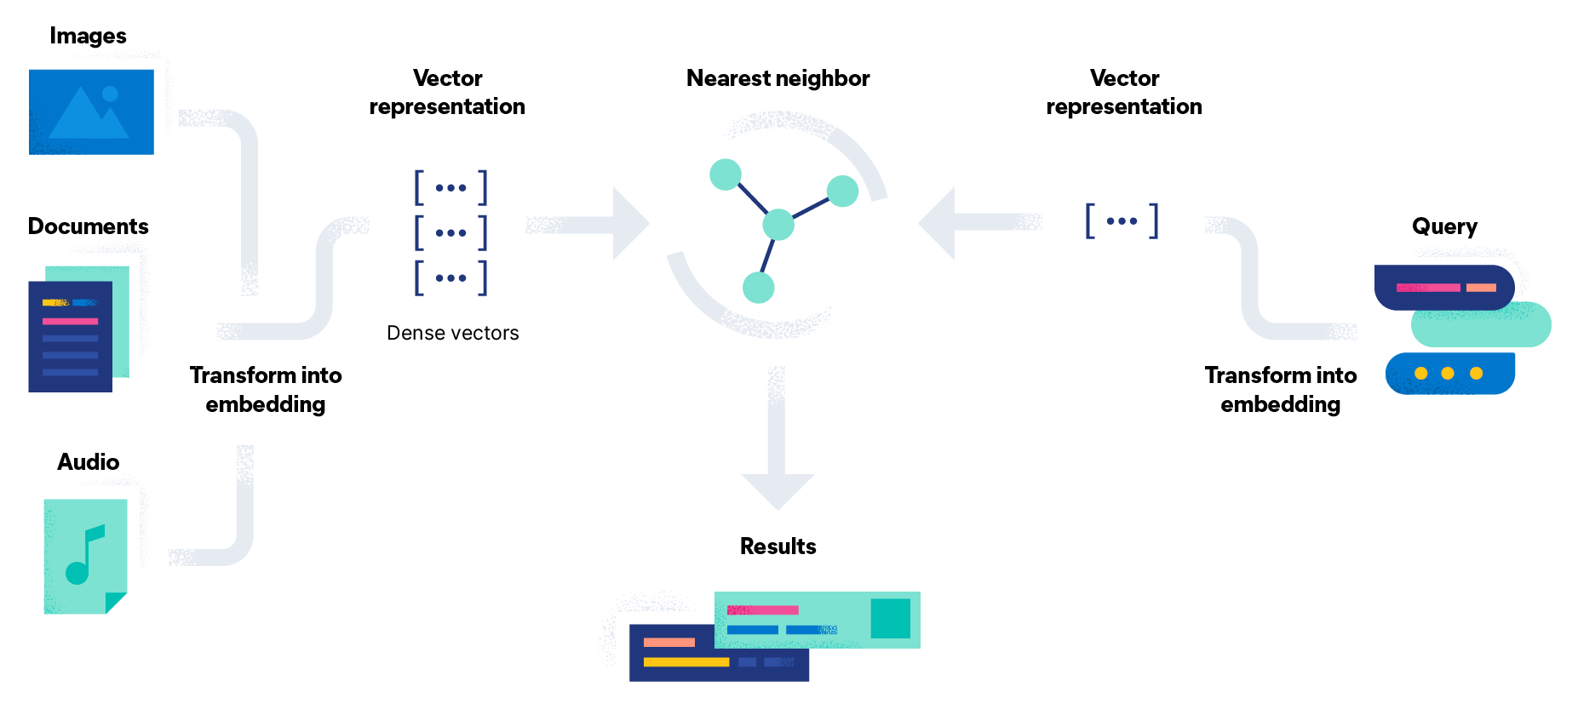
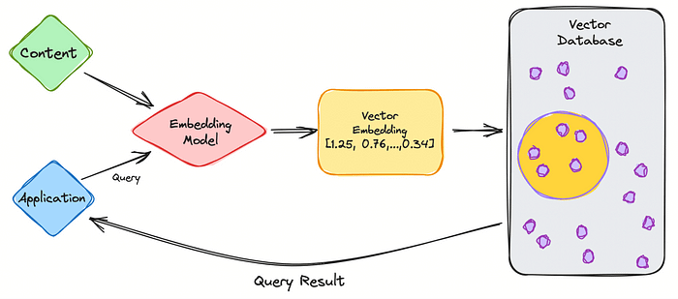
Notes:
A vector database works by using algorithms to index and query vector embeddings.
The algorithms enable approximate nearest neighbor (ANN) search through hashing, quantization, or graph-based search.
To retrieve information, an ANN search finds a query’s nearest vector neighbor.
Less computationally intensive than a kNN search (known nearest neighbor, or true k nearest neighbor algorithm), an approximate nearest neighbor search is also less accurate.
However, it works efficiently and at scale for large datasets of high-dimensional vectors.

Slide 11
Vector database Pipeline
Indexing: Using hashing, quantization, or graph-based techniques, a vector database indexes vectors by mapping them to a given data structure. This enables a faster search.
Hashing: A hashing algorithm, such as the locality-sensitive hashing (LSH) algorithm, is best suited to and then compared to a set of vectors in the same table to determine similarity.
Quantization: A quantization technique, such as product quantization (PQ), will break up vectors into smaller parts and represent those parts with code, and then put the parts back together. The result is a code representation of a vector and its components. The ensemble of these codes is referred to as a codebook. When queried, a vector database that uses quantization will break the query down into code, and then match it against the codebook to find the most similar code to generate results.
Graph-based: A graph algorithm, such as the Hierarchical Navigable Small World (HNSW) algorithm uses nodes to represent vectors. It clusters the nodes and draws lines or edges between similar nodes, creating hierarchical graphs. When a query is launched, the algorithm will navigate the graph hierarchy to find nodes containing the vectors that are most similar to the query vector.
Querying: When a vector database receives a query, it compares indexed vectors to the query vector to determine the nearest vector neighbors. To establish nearest neighbors, a vector database relies on mathematical methods known as similarity measures. Different types of similarity measures exist:
Cosine similarity establishes similarity on a range of -1 to 1. By measuring the cosine of the angle between two vectors in a vector space, it determines vectors that are diametrically opposed (represented by -1), orthogonal (represented by 0), or identical (represented by 1).
Euclidean distance determines similarity on a range of 0 to infinity by measuring the straight line distance between vectors. Identical vectors are represented by 0, while greater values represent a greater difference between vectors.
Dot product similarity measures determine vector similarity on a range of minus infinity to infinity. By measuring the product of the magnitude of two vectors and the cosine of the angle between them, dot product assigns negative values to vectors that point away from each other, 0 to orthogonal vectors, and positive values to vectors that point in the same direction.
Post-processing: The final step in a vector database pipeline is sometimes post-processing, or post-filtering, during which the vector database will use a different similarity measure to re-rank the nearest neighbors. At this stage, the database will filter the query's nearest neighbors identified in the search based on their metadata.
Some vector databases may apply filters before running a vector search. In this case, it is referred to as preprocessing or pre-filtering.

Slide 12
Why are vector databases important?
Vector databases are important because they hold vector embeddings and enable a set of capabilities, including indexing, distance metrics, and similarity search. In other words,
vector databases are specialized for the management of unstructured data and semi-structured data.
As a result, vector databases are a vital tool in the machine learning and AI digital landscape.

Slide 13
Applications of vector databases
Vector databases are used in AI, machine learning (ML), natural language processing (NLP), and image recognition applications.
AI/ML applications: A vector database can improve AI capabilities with semantic information retrieval and long-term memory.
NLP applications: Vector similarity search, a key component of vector databases, is useful for natural language processing applications. A vector database can process text embeddings, which enables a computer to "understand" human — or natural — language.
Image recognition and retrieval applications: Vector databases transform images into image embeddings. With similarity search, they are able to retrieve similar images or identify matching images.

Slide 14
How do vector databases identify similarities between vectors?
Cosine Similarity
Euclidean Distance
Manhattan Distance (L1 Distance)
Minkowski Distance
Jaccard Similarity
Hamming Distance
Pearson Correlation Coefficient
Spearman Rank Correlation
Kullback-Leibler Divergence
Earth Mover's Distance (EMD)
Notes:
A vector database determines the similarity between vectors using various mathematical techniques, with one of the most common methods being cosine similarity

Slide 15
Vector Database Capabilities
Efficient Similarity Search
High-Dimensional Data
Machine Learning and AI
Real-time Applications
Personalization and User Profiling
Spatial and Geographic Data
Healthcare and Life Sciences
Data Fusion and Integration
Multilingual Search
Graph Data

Slide 16
The Crucial Role of Vector Databases in Today’s Data Landscape
Vector databases are experiencing high demand due to their essential role in tackling the challenges posed by the explosion of high-dimensional data in modern applications.
As industries increasingly adopt technologies like machine learning, artificial intelligence, and data analytics, the need to efficiently store, search, and analyze complex data representations has become paramount.
Vector databases enable businesses to harness the power of similarity search, personalized recommendations, and content retrieval, driving enhanced user experiences and improved decision-making.
With applications ranging from e-commerce and content platforms to healthcare and autonomous vehicles, the demand for vector databases stems from their ability to handle diverse data types and deliver accurate results in real time.
As data continues to grow in complexity and volume, the scalability, speed, and accuracy offered by vector databases position them as a critical tool for extracting meaningful insights and unlocking new opportunities across various domains.

Slide 17
OpenAI - Embedding models
MODEL | ~ PAGES PER DOLLAR | PERFORMANCE ON MTEB EVAL | MAX INPUT
text-embedding-3-small | 62,500 | 62.3% | 8191
text-embedding-3-large | 9,615 | 64.6% | 8191
text-embedding-ada-002 | 12,500 | 61.0% | 8191

Slide 18
List of Open Source Embeddings models
Word2Vec
GloVe (Global Vectors for Word Representation)
FastText
BERT (Bidirectional Encoder Representations from Transformers)
Sentense transformers (
ELMo (Embeddings from Language Models)
Doc2Vec
Universal Sentence Encoder
Siamese Neural Networks
ResNet
VGG16/VGG19
BERT-based Models (e.g., RoBERTa, DistilBERT, ALBERT)
Graph Embedding Models (e.g., GraphSAGE, Node2Vec)

Slide 19
What if the dimension of the embedding model is more?
Increased Semantic Representation
What if the dimension of the embedding model is small?
Limited Semantic Representation
Reduced Discriminative Power
Increased Similarity Among Unrelated Items
Lower Generalization Performance
Efficiency
Enhanced Discriminative Power
Improved Generalization Performance
Reduced Similarity Among Unrelated Items
Increased Computational Complexity
Effect of change in the dimension of Embedding Model?

Slide 20
Methods for Similarity search
Cosine Similarity
Euclidean Distance
Manhattan Distance (L1 Distance)
Minkowski Distance
Jaccard Similarity
Hamming Distance
Pearson Correlation Coefficient
Spearman Rank Correlation
Kullback-Leibler Divergence
Earth Mover's Distance (EMD)

